Slide 1
The Cell Cycle
Mitosis: the process by which cells reproduce themselves, resulting in daughter cells that contain the same amount of genetic material as the parent cell.

Slide 2
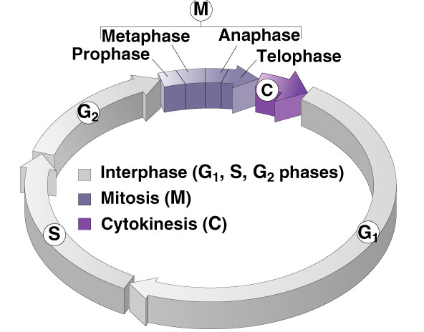
Phases of the Cell Cycle
Interphase
G₁ - primary growth
S - genome replicated
G₂ - secondary growth
M - mitosis
C - cytokinesis

Slide 3
Interphase – G₂ Stage
2nd Growth Stage
Occurs after DNA has been copied
All cell structures needed for division are made (e.g. centrioles)
Both organelles & proteins are synthesized

Slide 4
Mitosis
Some haploid & diploid cells divide by mitosis.
Each new cell receives one copy of every chromosome that was present in the original cell.
Produces 2 new cells that are both genetically identical to the original cell.
DNA duplication during interphase
Mitosis
Diploid Cell

Slide 5
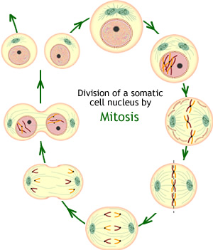
Mitosis Cycle
Interphase
Prophase
Metaphase
Anaphase
Telophase
Cytokinesis
http://www.cellsalive.com/mitosis.htm

Slide 6
Cell Division Occurs in a series of stages of phases

Slide 7
Interphase occurs before mitosis begins
Chromosomes are copied (# doubles)
Chromosomes appear as threadlike coils (chromatin) at the start, but each chromosome and its copy(sister chromosome) change to sister chromatids at end of this phase
CELL MEMBRANE
Nucleus
Cytoplasm

Slide 8
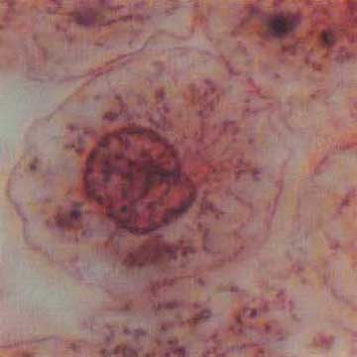
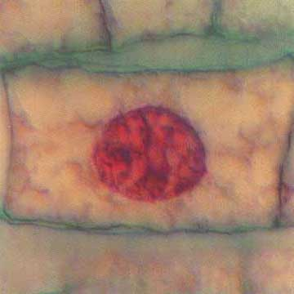
Interphase
Animal Cell
Plant Cell
Photographs from: http://www.bioweb.uncc.edu/biol1110/Stages.htm

Slide 9
Interphase
G₁ - Cells undergo majority of growth
S - Each chromosome replicates (Synthesizes) to produce sister chromatids
Attached at centromere
Contains attachment site (kinetochore)
G₂ - Chromosomes condense - Assemble machinery for division such as centrioles

Slide 10
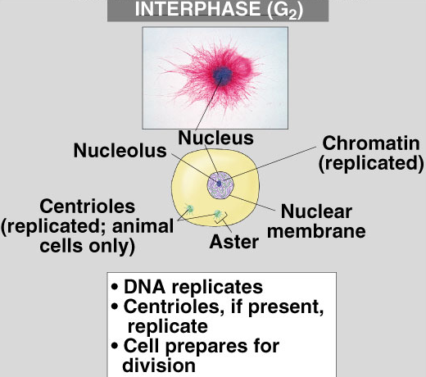
What’s Happening in Interphase?
What the cell looks like
Animal Cell
What’s occurring

Slide 11
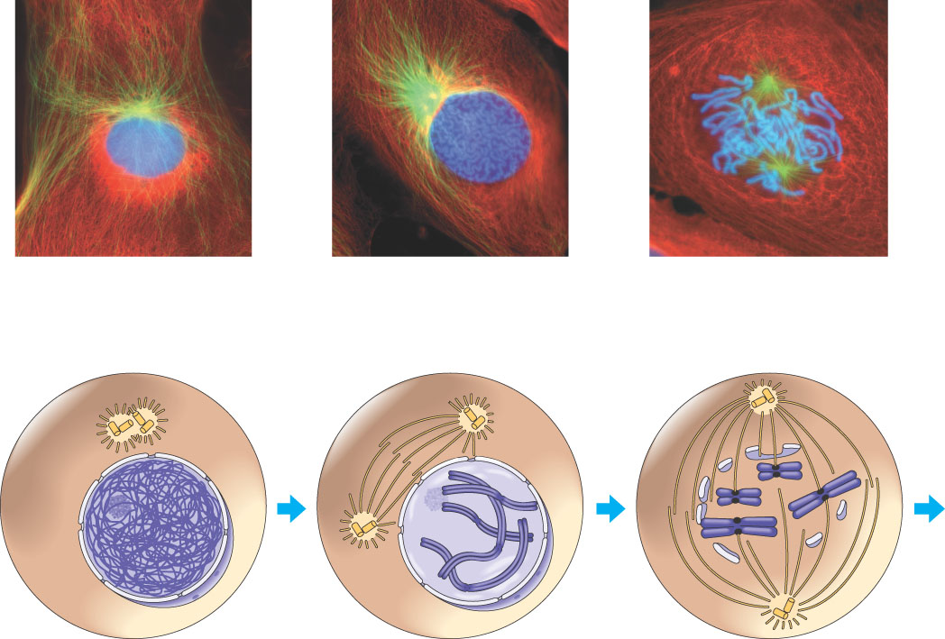
G₂ of Interphase
A nuclear envelope bounds the nucleus.
The nucleus contains one or more nucleoli (singular, nucleolus).
Two centrosomes have formed by replication of a single centrosome.
In animal cells, each centrosome features two centrioles.
Chromosomes, duplicated during S phase, cannot be seen individually because they have not yet condensed.
The light micrographs show dividing lung cells from a newt, which has 22 chromosomes in its somatic cells (chromosomes appear blue, microtubules green, intermediate filaments red). For simplicity, the drawings show only four chromosomes.
G₂ OF INTERPHASE
Centrosomes (with centriole pairs)
Chromatin (duplicated)
Nucleolus
Nuclear envelope
Plasma membrane

Slide 12
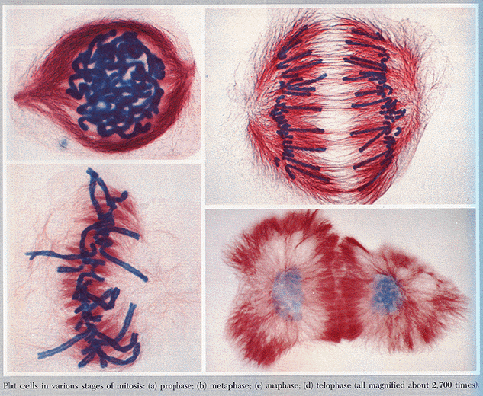
Mitosis
Division of the nucleus
Also called karyokinesis
Only occurs in eukaryotes
Has four stages
Doesn’t occur in some cells such as brain cells

Slide 13
Four Mitotic Stages
Prophase
Metaphase
Anaphase
Telophase

Slide 14
Prophase 1st step in Mitosis
Mitosis begins (cell begins to divide)
Centrioles (or poles) appear and begin to move to opposite end of the cell.
Spindle fibers form between the poles.
Centrioles
Sister chromatids
Spindle fibers

Slide 15
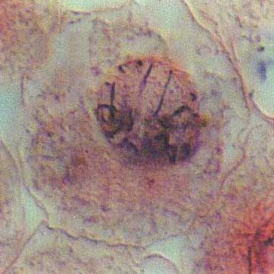
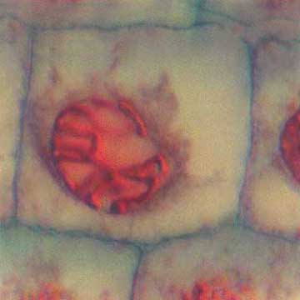
Prophase
Animal Cell
Plant Cell
Photographs from: http://www.bioweb.uncc.edu/biol1110/Stages.htm

Slide 16
Prophase
The chromatin fibers become more tightly coiled, condensing into discrete chromosomes observable with a light microscope.
The nucleoli disappear.
Each duplicated chromosome appears as two identical sister chromatids joined together.
The mitotic spindle begins to form. It is composed of the centrosomes and the microtubules that extend from them. The radial arrays of shorter microtubules that extend from the centrosomes are called asters (“stars”).
The centrosomes move away from each other, apparently propelled by the lengthening microtubules between them.
PROPHASE
Early mitotic spindle
Aster
Centromere
Chromosome, consisting of two sister chromatids

Slide 17
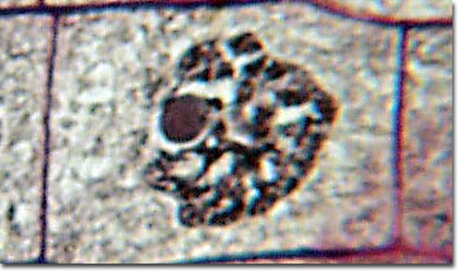
Early Prophase
Chromatin in nucleus condenses to form visible chromosomes
Mitotic spindle forms from fibers in cytoskeleton or centrioles (animal)
Nucleolus
Cytoplasm
Nuclear Membrane
Chromosomes

Slide 18
Late Prophase
Nuclear membrane & nucleolus are broken down
Chromosomes continue condensing & are clearly visible
Spindle fibers called kinetochores attach to the centromere of each chromosome
Spindle finishes forming between the poles of the cell

Slide 19
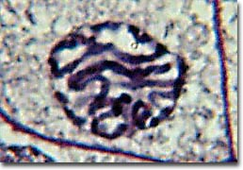
Late Prophase
Chromosomes
Nucleus & Nucleolus have disintegrated

Slide 20
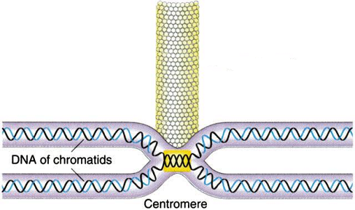
Spindle Fiber attached to Chromosome
Kinetochore Fiber
Chromosome

Slide 21
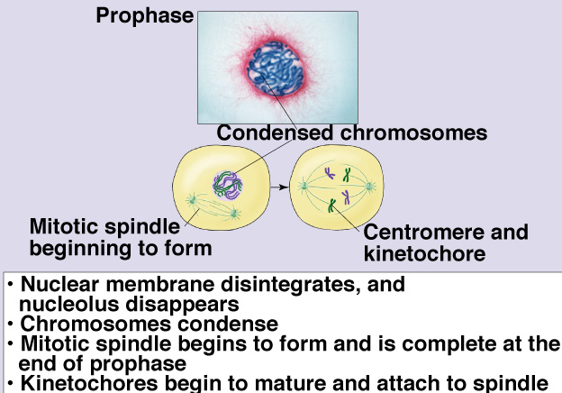
Review of Prophase
What the cell looks like
What’s happening

Slide 22
Spindle Fibers
The mitotic spindle form from the microtubules in plants and centrioles in animal cells
Polar fibers extend from one pole of the cell to the opposite pole
Kinetochore fibers extend from the pole to the centromere of the chromosome to which they attach
Asters are short fibers radiating from centrioles

Slide 23
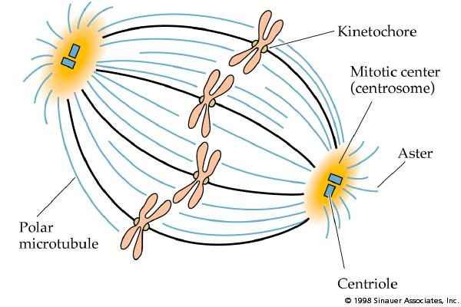
Sketch The Spindle

Slide 24
Metaphase 2nd step in Mitosis
Chromatids (or pairs of chromosomes) attach to the spindle fibers.
Centrioles
Spindle fibers

Slide 25
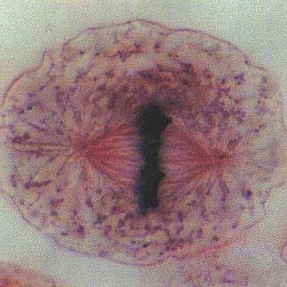
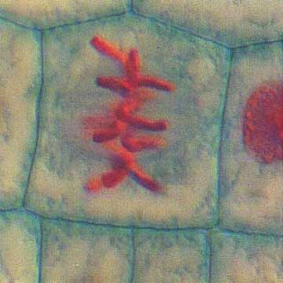
Metaphase
Animal Cell
Plant Cell
Photographs from: http://www.bioweb.uncc.edu/biol1110/Stages.htm

Slide 26
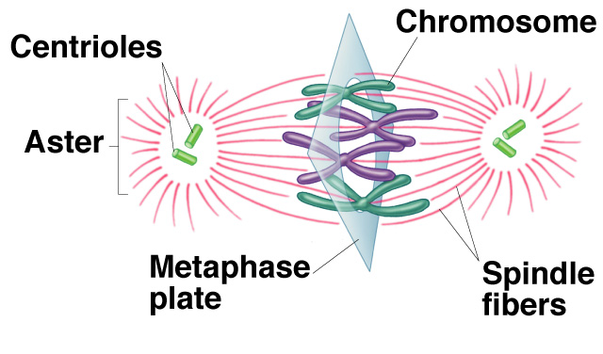
Metaphase
Chromosomes, attached to the kinetochore fibers, move to the center of the cell
Chromosomes are now lined up at the equator
Equator of Cell
Pole of the Cell

Slide 27
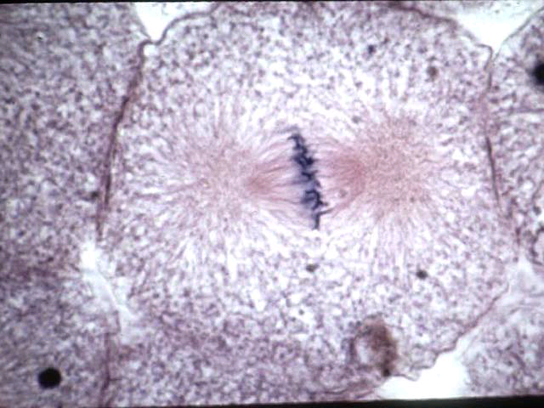
Metaphase
Asters at the poles
Spindle Fibers
Chromosomes lined at the Equator

Slide 28
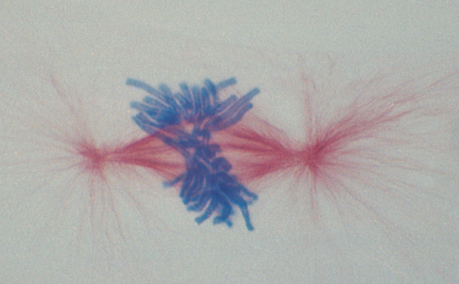
Metaphase
Aster
Chromosomes at Equator

Slide 29
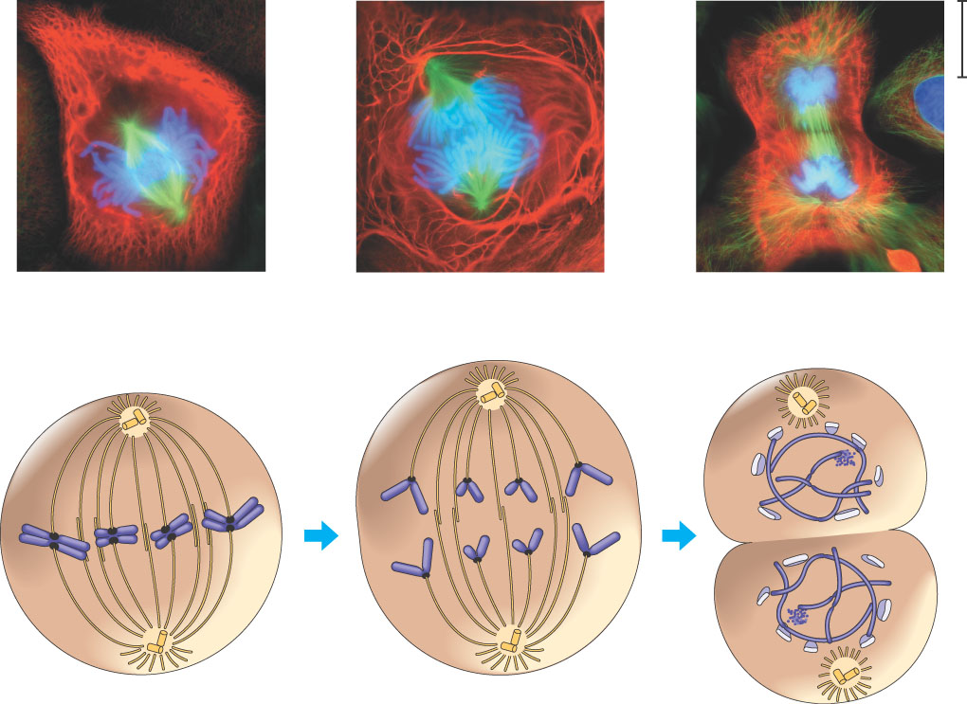
Metaphase
Metaphase is the longest stage of mitosis, lasting about 20 minutes.
The centrosomes are now at opposite ends of the cell.
The chromosomes convene on the metaphase plate, an imaginary plane that is equidistant between the spindle’s two poles. The chromosomes’ centromeres lie on the metaphase plate.
For each chromosome, the kinetochores of the sister chromatids are attached to kinetochore microtubules coming from opposite poles.
The entire apparatus of microtubules is called the spindle because of its shape.
METAPHASE
Metaphase plate
Spindle
Centrosome at one spindle pole

Slide 30
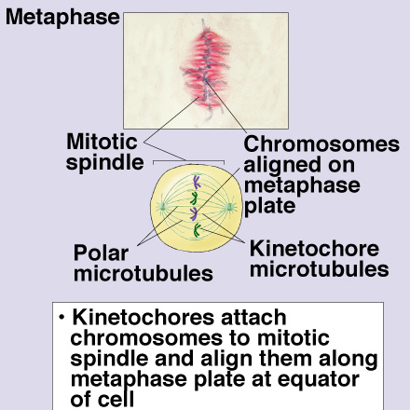
Review of Metaphase
What the cell looks like
What’s occurring

Slide 31
The Mitotic Spindle
The spindle includes the centrosomes, the spindle microtubules, and the asters
The apparatus of microtubules controls chromosome movement during mitosis
The centrosome replicates, forming two centrosomes that migrate to opposite ends of the cell
Assembly of spindle microtubules begins in the centrosome, the microtubule organizing center
An aster (a radial array of short microtubules) extends from each centrosome

Slide 32
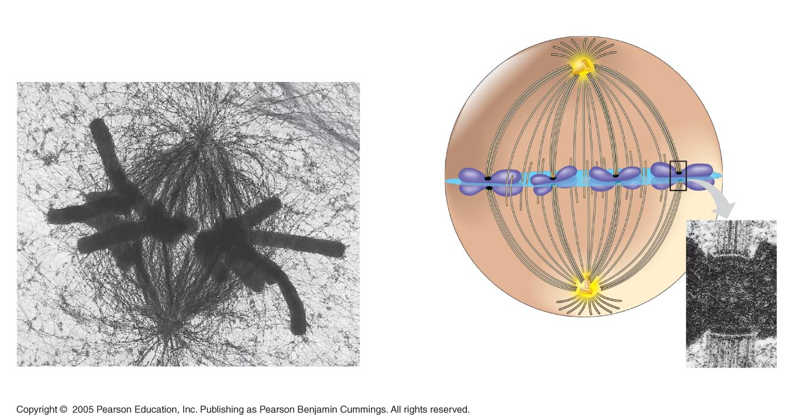
The Mitotic Spindle
Some spindle microtubules attach to the kinetochores of chromosomes and move the chromosomes to the metaphase plate
In anaphase, sister chromatids separate and move along the kinetochore microtubules toward opposite ends of the cell
Aster
Centrosome
Sister
chromatids
Microtubules
Chromosomes
Metaphase
plate
Kineto-
chores
Overlapping
nonkinetochore
microtubules
Kinetochore
microtubules
Centrosome
1 µm
0.5 µm

Slide 33
Anaphase 3rd step in Mitosis
Chromatids (or pairs of chromosomes) separate and begin to move to opposite ends of the cell.
Centrioles
Spindle fibers

Slide 34
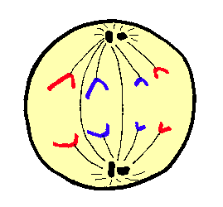
Anaphase
Occurs rapidly
Sister chromatids are pulled apart to opposite poles of the cell by kinetochore fibers

Slide 35
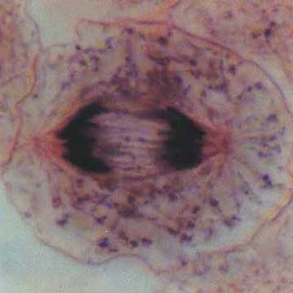
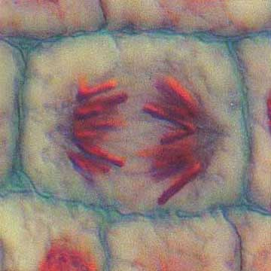
Anaphase
Animal Cell
Plant Cell
Photographs from: http://www.bioweb.uncc.edu/biol1110/Stages.htm

Slide 36
Anaphase
Anaphase is the shortest stage of mitosis, lasting only a few minutes.
Anaphase begins when the two sister chromatids of each pair suddenly part. Each chromatid thus becomes a full- fledged chromosome.
The two liberated chromosomes begin moving toward opposite ends of the cell, as their kinetochore microtubules shorten. Because these microtubules are attached at the centromere region, the chromosomes move centromere first (at about 1 µm/min).
The cell elongates as the nonkinetochore microtubules lengthen.
By the end of anaphase, the two ends of the cell have equivalent—and complete—collections of chromosomes.
ANAPHASE
Daughter chromosomes

Slide 37
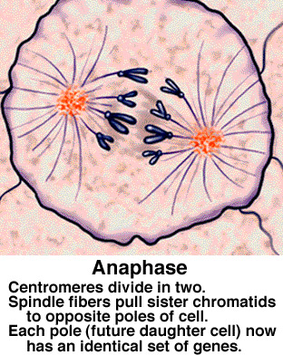
Anaphase Review
What the cell looks like
What’s occurring

Slide 38
Telophase 4th step in Mitosis
Two new nuclei form.
Chromosomes appear as chromatin (threads rather than rods).
Mitosis ends.
Nuclei
Nuclei
Chromatin

Slide 39
Telophase
Sister chromatids at opposite poles
Spindle disassembles
Nuclear envelope forms around each set of sister chromatids
Nucleolus reappears
CYTOKINESIS occurs
Chromosomes reappear as chromatin

Slide 40
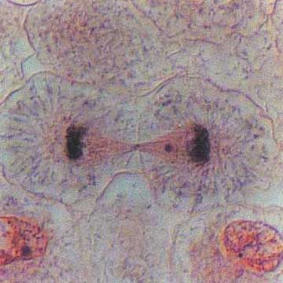
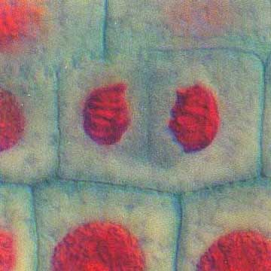
Telophase
Animal Cell
Plant Cell
Photographs from: http://www.bioweb.uncc.edu/biol1110/Stages.htm

Slide 41
Telophase
Two daughter nuclei begin to form in the cell.
Nuclear envelopes arise from the fragments of the parent cell’s nuclear envelope and other portions of the endomembrane system.
The chromosomes become less condensed.
Mitosis, the division of one nucleus into two genetically identical nuclei, is now complete.
TELOPHASE AND CYTOKINESIS
Cleavage furrow
Nucleolus forming
Nuclear envelope forming

Slide 42
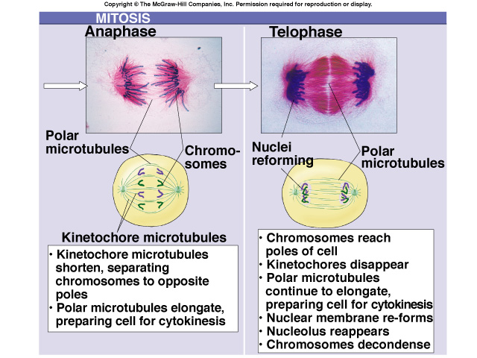
Comparison of Anaphase & Telophase

Slide 43
Cytokinesis occurs after mitosis
Cell membrane moves inward to create two daughter cells – each with its own nucleus with identical chromosomes.

Slide 44
Cytokinesis
Means division of the cytoplasm
Division of cell into two, identical halves called daughter cells
In plant cells, cell plate forms at the equator to divide cell
In animal cells, cleavage furrow forms to split cell

Slide 45
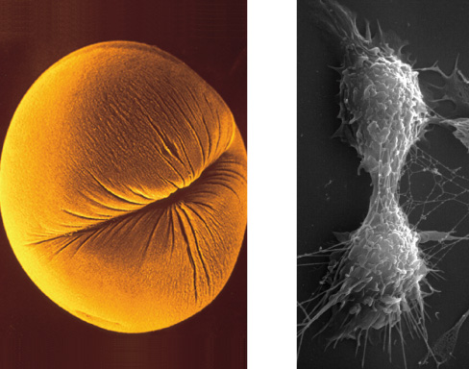
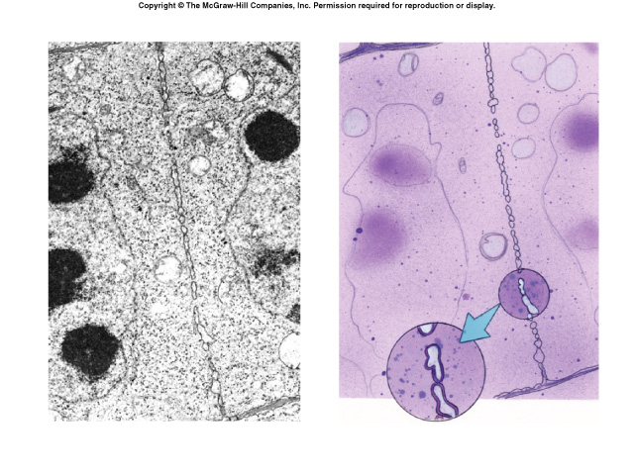
Cytokinesis
Cleavage furrow in animal cell
Cell plate in plant cell

Slide 46
Cytokinesis
Cleavage of cell into two halves
Animal cells
Constriction belt of actin filaments
Plant cells
Cell plate
Fungi and protists
Mitosis occurs within the nucleus

Slide 47
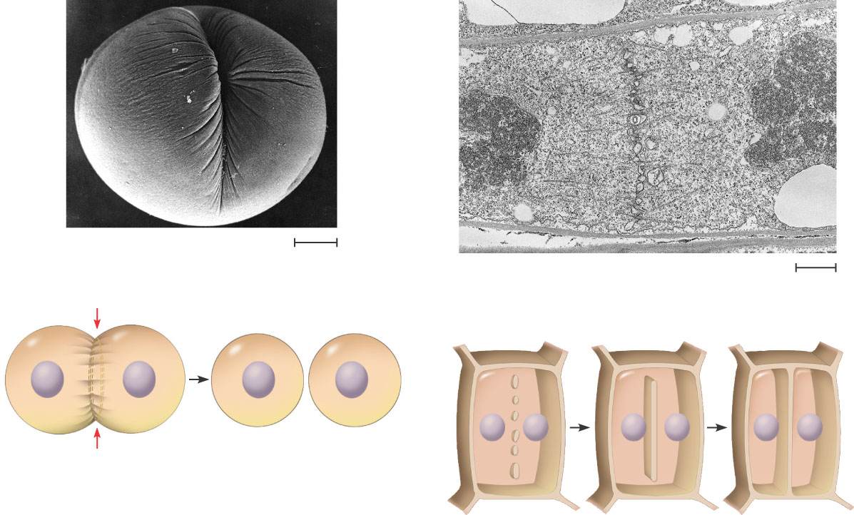
Cytokinesis In Animal And Plant Cells
Cleavage furrow
100 µm
Vesicles forming cell plate
Wall of patent cell
1 µm
Cell plate
New cell wall
Contractile ring of microfilaments
Daughter cells
Daughter cells
(a) Cleavage of an animal cell (SEM)
(b) Cell plate formation in a plant cell (SEM)

Slide 48
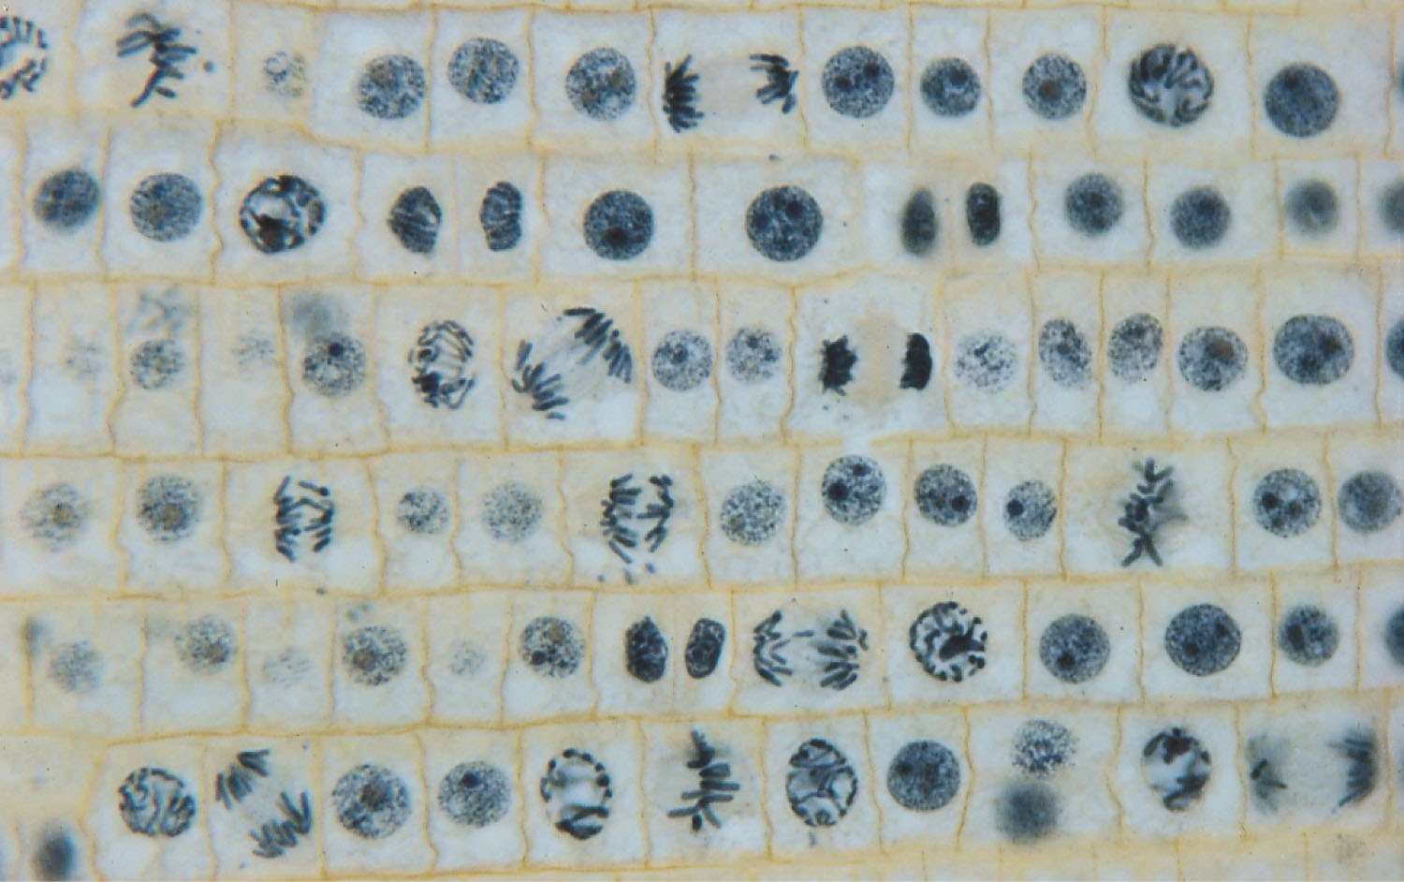

Slide 49
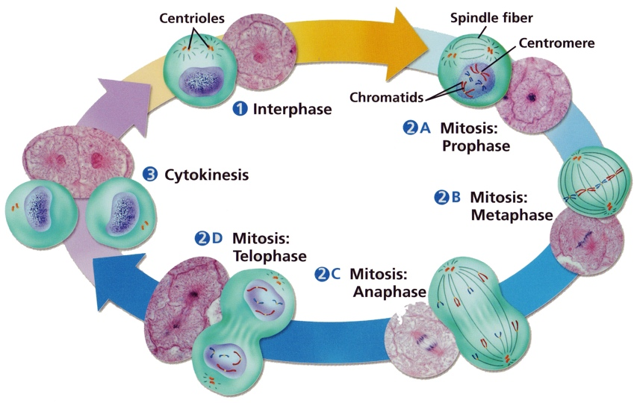
Cell Cycle

Slide 50
Mitotic Division of an Animal Cell
G₂ OF INTERPHASE
PROPHASE
PROMETAPHASE
Centrosomes (with centriole pairs)
Early mitotic spindle
Aster
Fragments of nuclear envelope
Chromatin (duplicated)
Kinetochore
Centromere
Nonkinetochore microtubules
Nucleolus
Nuclear envelope
Plasma membrane
Chromosome, consisting of two sister chromatids
Kinetochore microtubule

Slide 51
Mitotic Division of an Animal Cell
METAPHASE
ANAPHASE
TELOPHASE AND CYTOKINESIS
Metaphase plate
Cleavage furrow
Nucleolus forming
Nuclear envelope forming
Spindle
Centrosome at one spindle pole
Daughter chromosomes

Slide 52
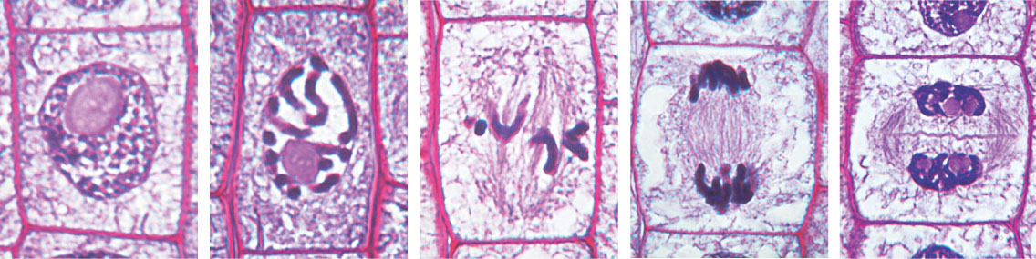
Mitosis in a plant cell
Nucleus
Chromatine condensing
Chromosome
Nucleolus
1
Prophase. The chromatin is condensing. The nucleolus is beginning to disappear. Although not yet visible in the micrograph, the mitotic spindle is staring to from.
2
Prometaphase. We now see discrete chromosomes; each consists of two identical sister chromatids. Later in prometaphase, the nuclear envelop will fragment.
3
Metaphase. The spindle is complete, and the chromosomes, attached to microtubules at their kinetochores, are all at the metaphase plate.
5
Telophase. Daughter nuclei are forming. Meanwhile, cytokinesis has started: The cell plate, which will divided the cytoplasm in two, is growing toward the perimeter of the parent cell.
4
Anaphase. The chromatids of each chromosome have separated, and the daughter chromosomes are moving to the ends of cell as their kinetochore microtubles shorten.

Slide 53
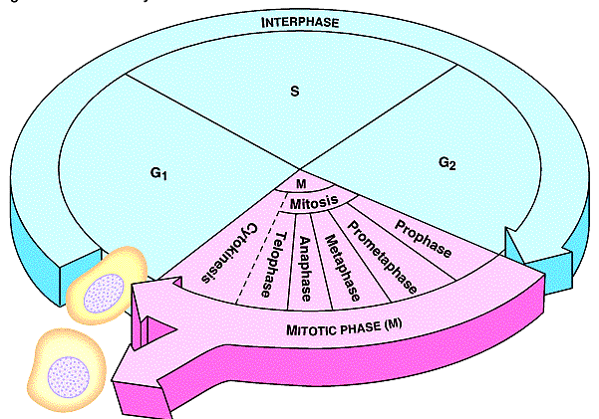
Sketch the Cell Cycle
DNA Copied
Cells prepare for Division
Cells Mature
Daughter Cells
Cell Divides into Identical cells

